Slide 2
Founding Sponsors

Slide 3
Program Sponsor
Securities and Advisory Services offered through Commonwealth Financial Network®, member FINRA/SIPC, a Registered Investment Adviser. Fixed insurance products and services are separate from and are not offered through Commonwealth Financial Network.

Slide 4
Slides, External resources & registration can be found at www.solonchamber.com/slides
Materials will also be distributed by email after the program!

Slide 11
Enroll TODAY at www.solonchamber.com/wrsc

Slide 12
Private Employers Important Dates
June 21
Policy year 2023 first installment due
June 30
Deadline for Industry-Specific Safety Program (ISSP) loss prevention activities
Policy Activity Rebate (PAR) deadline to complete and record activities
Deadline for Grow Ohio safety requirements if coverage became effective between July 1 and Dec. 31
Notes:
Read slide

Slide 13
Safety Council Update
FY24 Starts July 1
Increase from 2% to 3% rebate with $5K cap
10 meeting credits needed
Up to 2 meeting credits for BWC classes or qualifying external safety classes
Must have one person present per policy

Slide 14
Grants Program
Funding opportunities are once again available for four of our special safety grant programs.
Trench Safety Grant. Available only to Ohio employers that perform trenching and excavating.
Firefighter Exposure to Environmental Elements Grant combats firefighter cancer risk.
Employers Working with Persons with Developmental Disabilities Grant assists Ohio employers with ensuring the safety of their staff when carrying out the services they provide to developmentally disabled children and adults. **ENDING 6/30/23
School Safety and Security Grant provides assistance to Ohio employers with ensuring the safety of their staff who instruct children throughout the state.

Slide 15
Grants Programs cont’d. Safety Intervention Grants Program
Purchase equipment to eliminate or significantly reduce hazards in the workplace.
3:1 match up to $40,000
Renewable every 3 years
One year case study/annual report
In business for one year

Slide 16
BWC Monthly Employer Webinars
The June webinar will include:
Annual employer True-up
Reportable payroll
Early pay discount
Important dates
Monthly safety topic
Next webinar: Tuesday, June 13, 1:30 PM
Thursday, June 29, 11:30 AM

Slide 17
Securities and Advisory Services offered through Commonwealth Financial Network®, member FINRA/SIPC, a Registered Investment Adviser. Fixed insurance products and services are separate from and are not offered through Commonwealth Financial Network.

Slide 18
Firm History
1986
Ashok Shendure, Swagelok's Chief Engineer,
leaves to pursue his burning desire and
passion for personal finance.
2009
Joined Commonwealth Financial Network®.
2023
Business fully transitioned to the next
generation of advisors.

Slide 19
About Me
Chagrin Valley Rotary Scholarship Recipient
Ashland University Graduate
CFP® Professional
Financial Advisor
Joined BDS in 2008 after meeting Ashok Shendure at a scholarship breakfast for The Rotary Club of Chagrin Valley.
Earned a bachelor’s degree in business administration from Ashland University (Class of 2011).
Became a CERTIFIED FINANCIAL PLANNER™ professional in 2017.
Professionally serve more than 150 individuals and businesses.

Slide 20
How can I help?
Financial Planning
Am I on track to reach my financial goals?
Investment Planning
Do I have the right investment in the right type of account?
Retirement Planning
How much can I safely withdraw from my retirement account?
Saving for College
What is the best way to help my child pay for college?
Tax Planning
Could tax-loss harvesting help offset larger gains this year?
Estate Planning
How is my property transferred at death?
Risk Management
Do I have the proper protection in place in the event of a long-term care event, death, disability, etc.?

Slide 21
Retirement Plans
Benchmarking - process of reviewing and evaluating your company retirement plan
Plan Design
Eligibility Requirements, Roth Provision, Loan Feature, Vesting Schedules, Company Contributions, Etc.
Service Providers
Recordkeeper, Third Party Administrator, Financial Advisor,
3(21) or 3(38) Fiduciary.
Funds
Representation of asset classes, fund performance vs category peers,
expense ratio vs alternatives.
Fees
Are the fees reasonable when compared to plans of similar size?

Slide 22
Contact Me
Cory Nutter, CFP®
Financial Advisor
30405 Solon Rd, Suite 16 • Solon, OH 44139
(440) 248-5625
cory@bdsfn.com
bdsfn.com

Slide 23
Ready Rating
2023

Slide 24
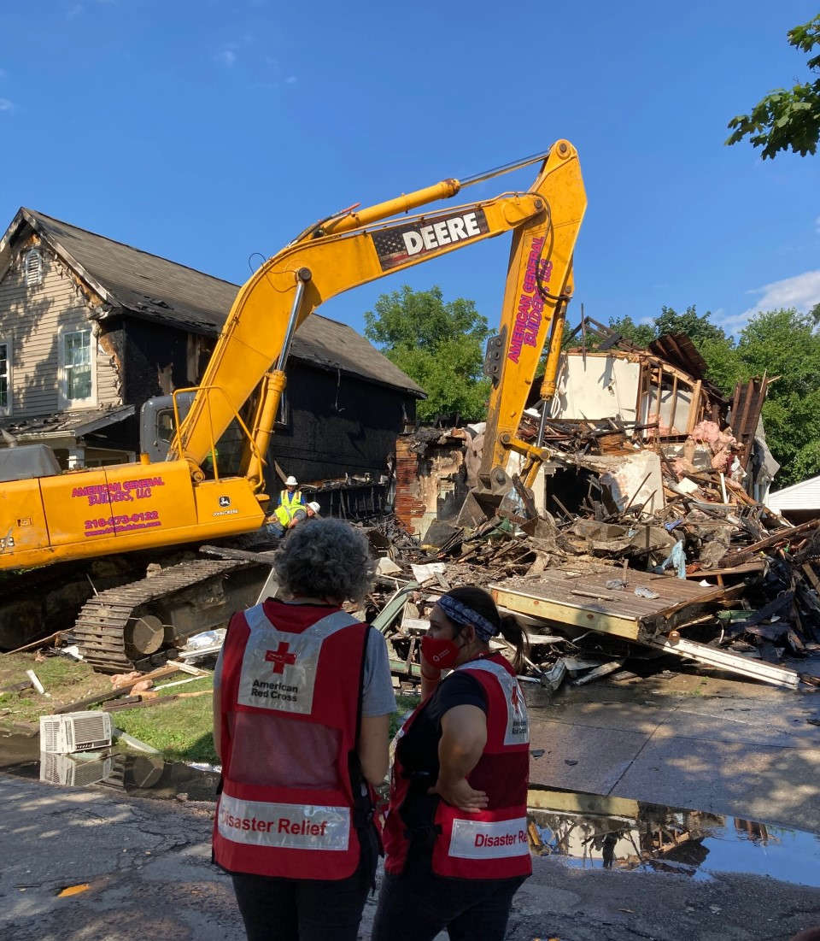
Agenda
Overview of the Mission
Response: Disaster Action Teams
Recovery: Casework
Large Disaster Response
Preparedness education
Volunteer Opportunities
Ready Rating Program

Slide 25
Notes:
40% of blood supply. In order to respond the event must be a disaster event – damage assessment. Funding is through donor dollars. 90 % of the work done by volunteers

Slide 26
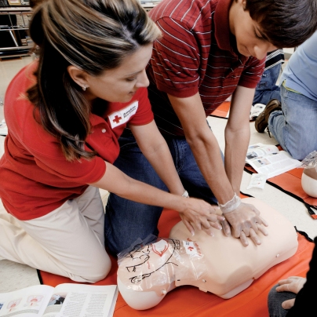
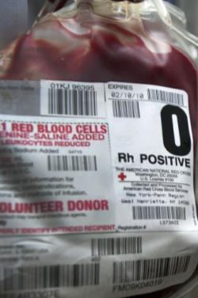
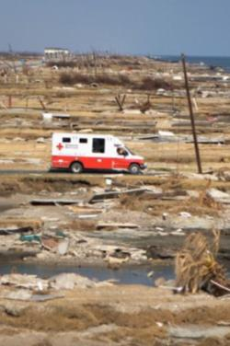
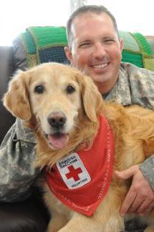
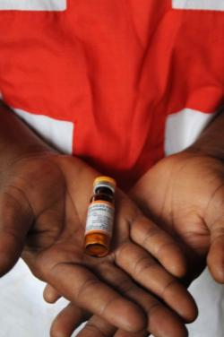
Our Services Today
Down the Street. Across the Country. Around the World.®
Training Services
Biomedical Services
Disaster Cycle Services
Service to the Armed Forces
International Services
Notes:
The Red Cross Mission is delivered through these 5 lines of service.
Training Services– Our training and educational programs help to save lives and empower people to respond to disasters and other life-threatening emergencies. Class offerings include CPR, First Aid and water safety, just to name a few.
Biomedical Services – For more than 60 years, we have been committed to ensuring the availability of safe blood and blood products to help meet America’s blood needs.
Disaster Cycle Services – From small to large disasters, we provide a safe place to stay, food to eat, health and mental health services and give out emergency supplies to those who are impacted by disaster. We also provide disaster preparedness education and free smoke alarm installations free of charge.
Services to the Armed Forces – We support our active-duty military members, National Guard and Reserve members, veterans and their families in various ways from emergency communication to reintegration help.
International Services – We provide reconnection services for families who have been separated by war, disaster or migration around the world. We also work with partners to ensure children across the world are properly vaccinated.
There are volunteer opportunities within all the lines of service but, due to this health crisis, many of our roles have transitioned to virtual or have been put on hold as we practice social distancing.
[click animations]However, some of our roles have become more critical. Today we will highlight how you can support Disaster relief efforts and our vital blood collections services.

Slide 27
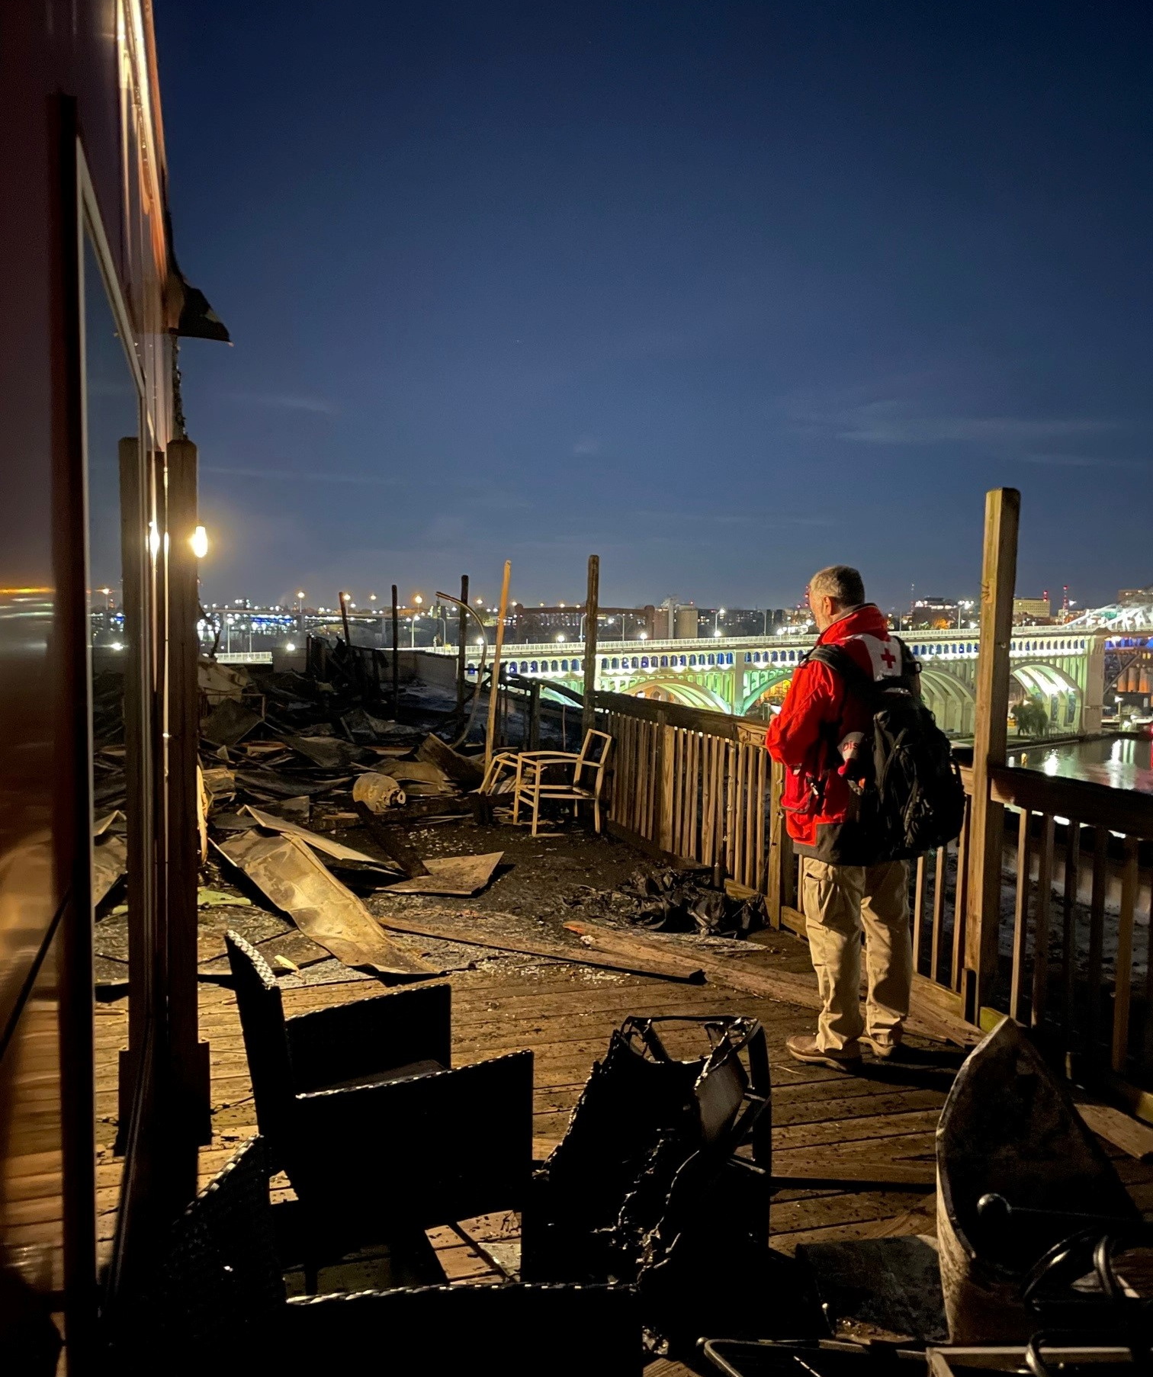
Acute to Chronic Nature of large disasters
A sixfold increase in the number of large disasters caused by extreme weather in the United States over the last 40 years.
More than 40% of Americans — some 130 million people — live in a county struck by a climate disaster last year.
Between 2008 and 2020, extreme weather caused by climate change displaced 10 million people.
For the most vulnerable, climate displacement can be catastrophic as it worsens the chronic underlying causes and threat of poverty.
Notes:
We have about 40 volunteers and staff who respond 24/7 265 in all weather. We developed procedures to respond during safely during COVID. Late night calls are the most rewarding – I am here to help. There is no charge for the assistance we provide.

Slide 28
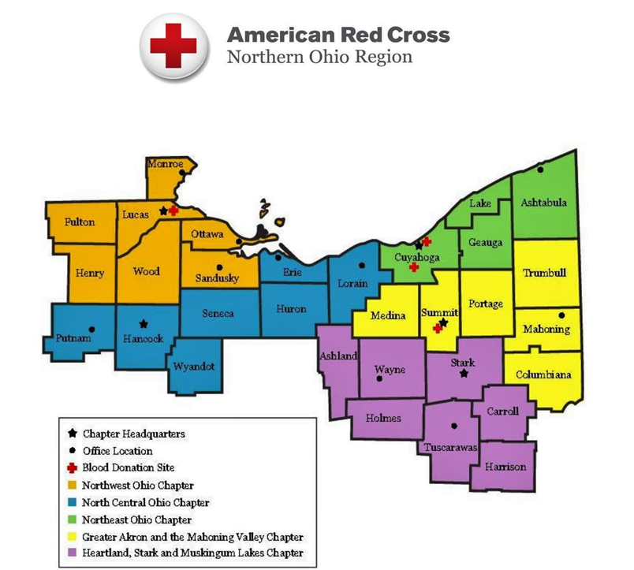
Statistics:
Northern Ohio Region: FY 22
Incidents: 1187
Assisting 4,731 people
Fatalities: 36
Canteen: 21
Northeast Ohio Chapter– FY 22
Incidents: 383
Assisting 1,468 People
Fatalities: 14
Canteen: 8
Notes:
Region $1.2m Neo Chapter $350,0000

Slide 29
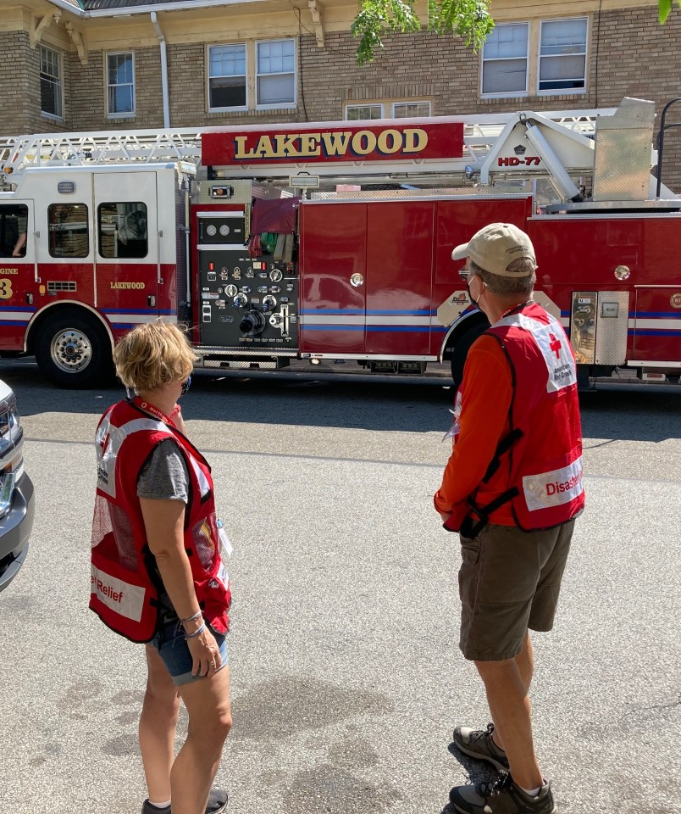
Response:
DAT - Disaster Action Team - on call 24/7 - 365
Listen to their story
Damage Assessment: (FEMA Guidelines)
Destroyed
Major
Uninhabitable
Minor
Affected
Immediate Assistance: Client Assistance Card - CAC Or EFT
Snacks and Water
Blankets, Toys and Comfort Kits
Canteen for 1st Responders and Clients
Notes:
We have about 40 volunteers and staff who respond 24/7 265 in all weather. We developed procedures to respond during safely during COVID. Late night calls are the most rewarding – I am here to help. There is no charge for the assistance we provide.

Slide 30
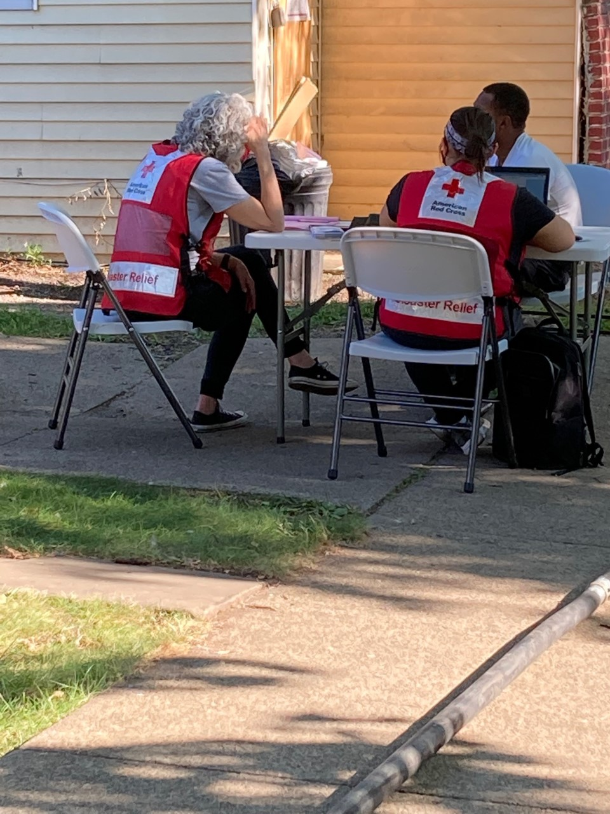
Recovery:
Guide the clients through the recovery process
Advocate for client
Referrals for Resources: ( findhelp.org )
Assistance in finding housing.
Additional funds available to help overcome roadblocks.
VSP – coupon to replace eyeglasses
Disaster Health Services – Assistance to replace medical equipment and medications.
Disaster Mental Health - Disaster coping skills
ICCT Team – hospitalizations and fatalities:
Specially Trained / Experienced Volunteers
Bereavement financial Assistance

Slide 31
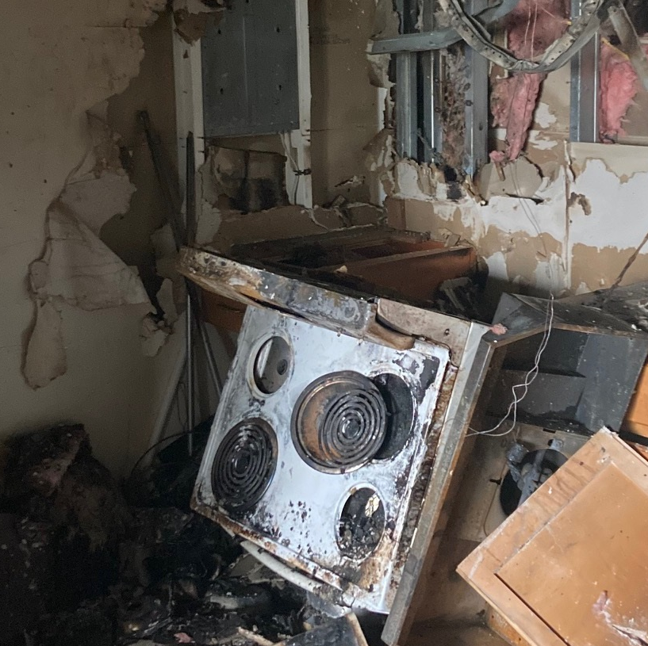
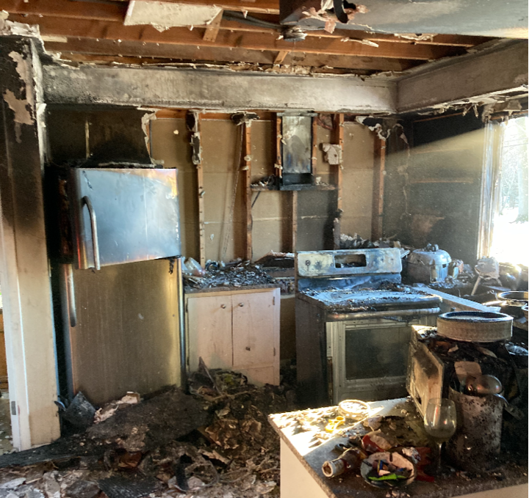
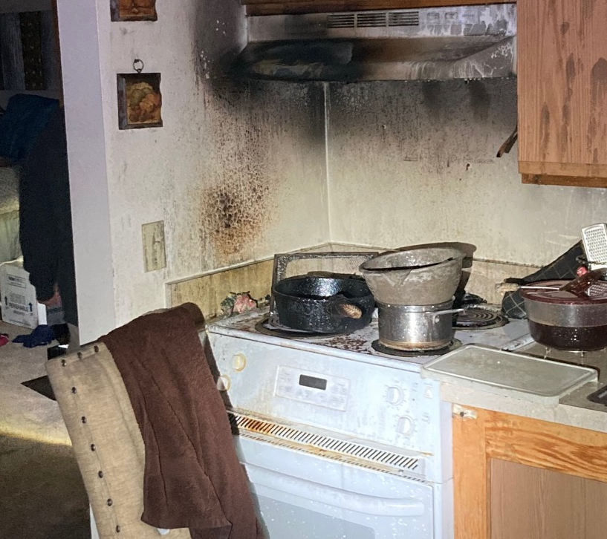
Kitchen Fires

Slide 32
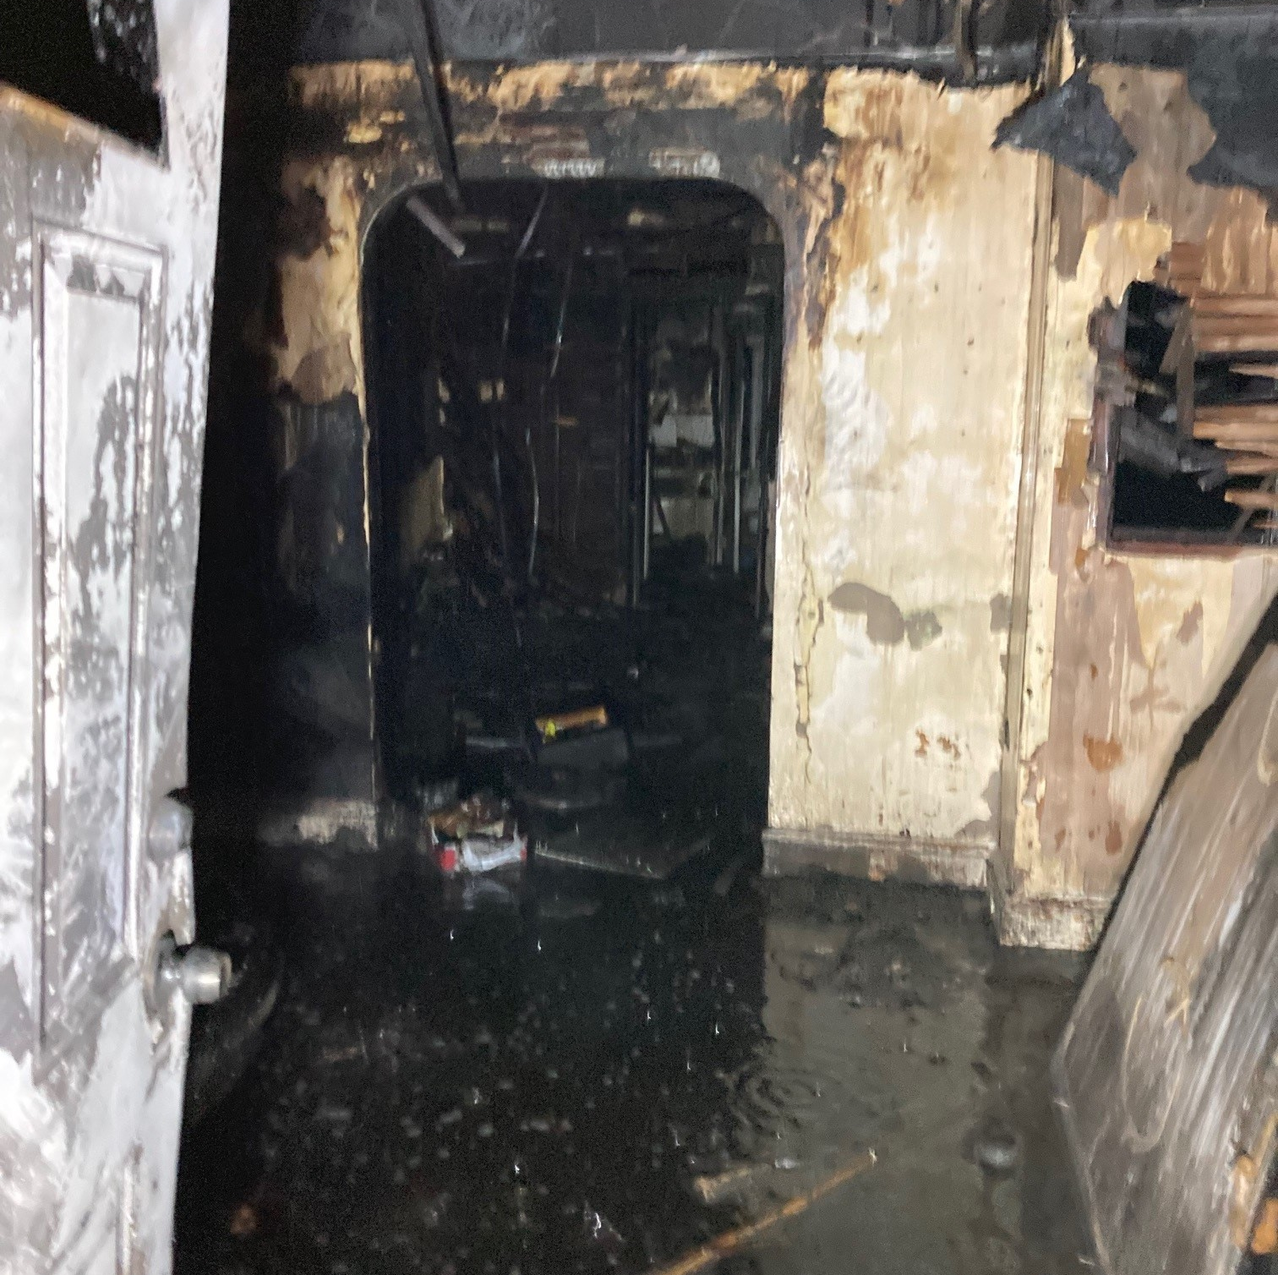
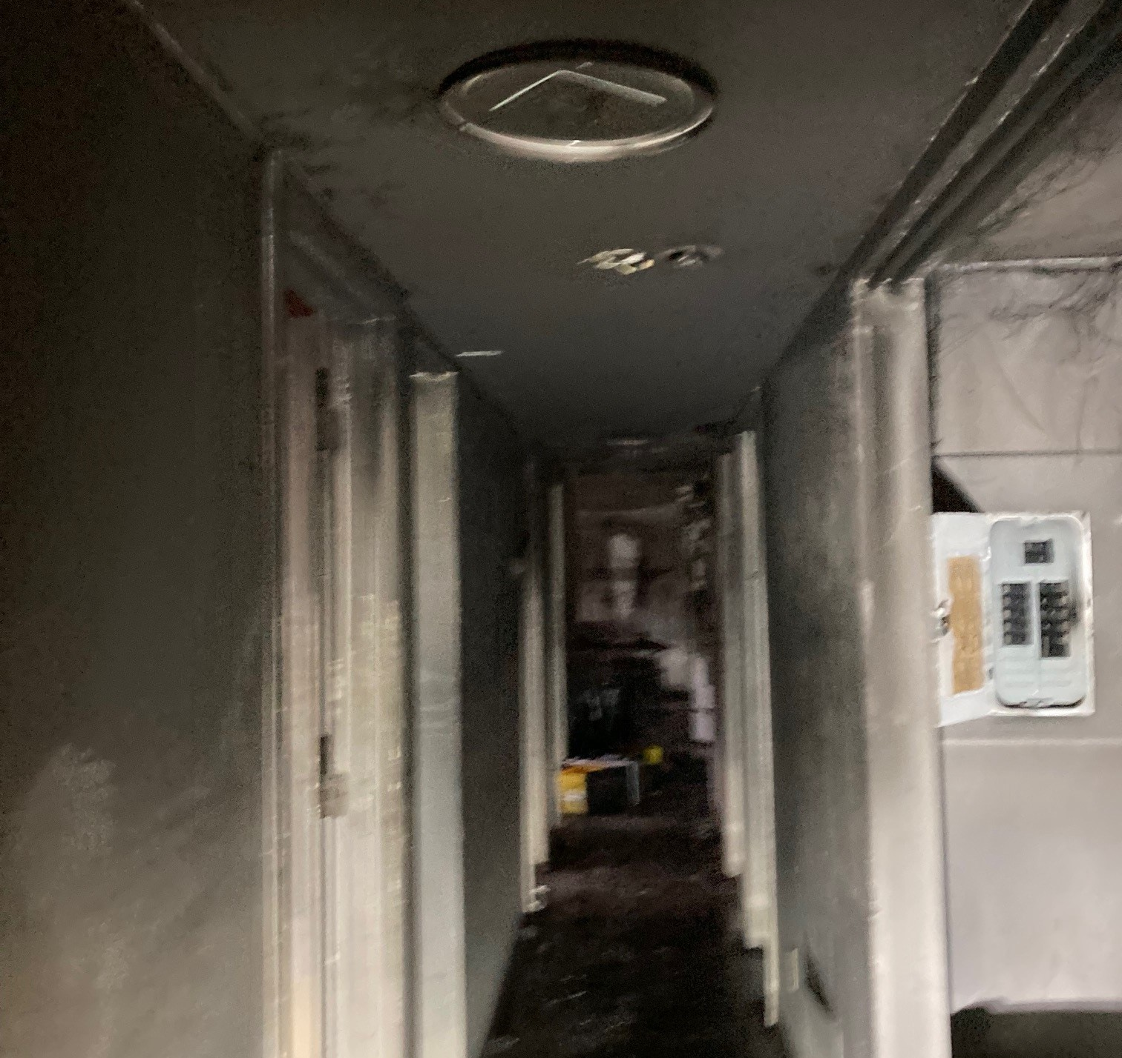
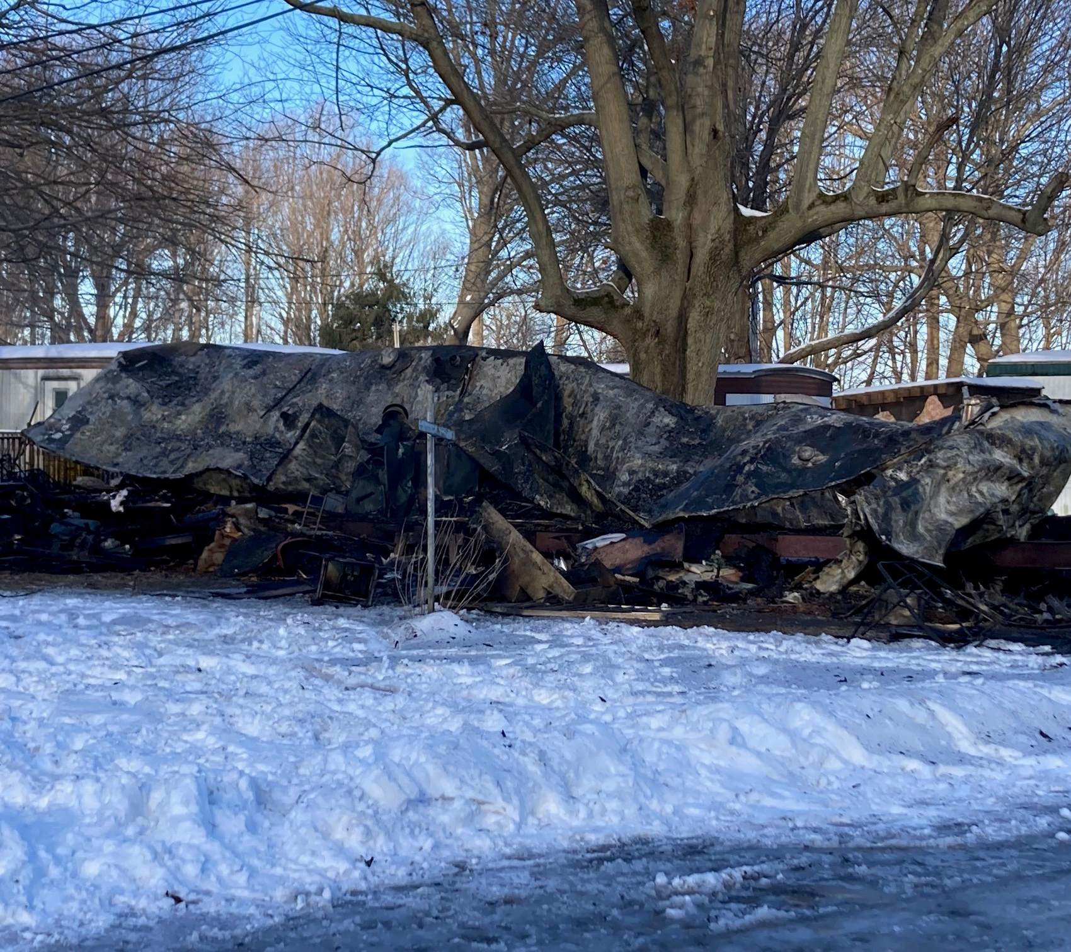
Home fires

Slide 33
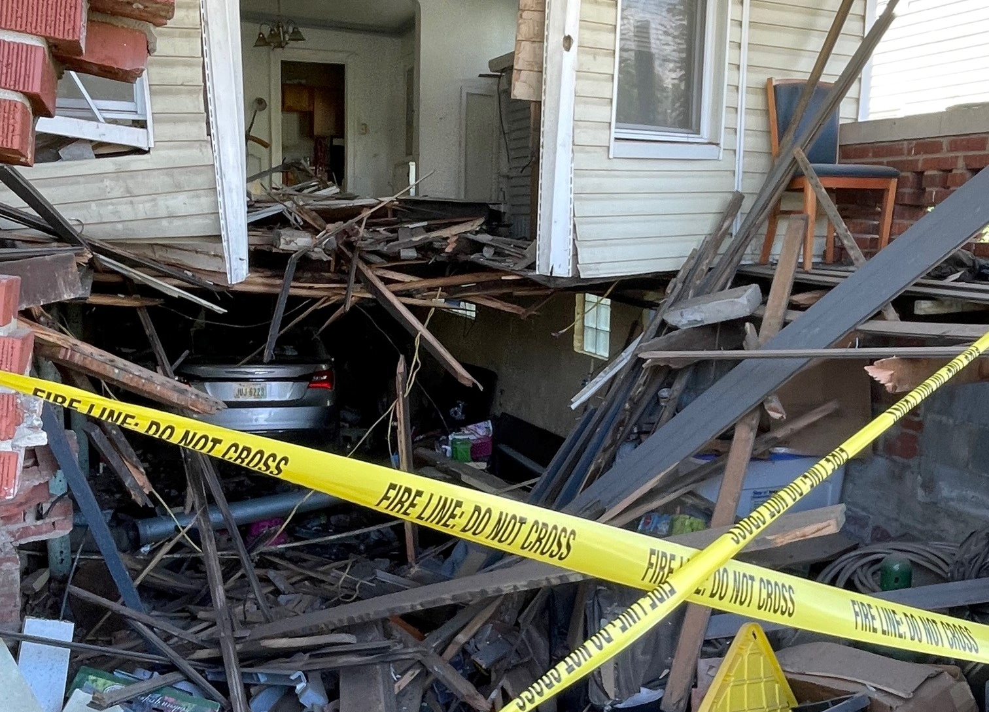
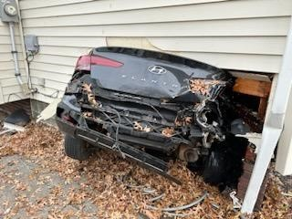
Vehicle vs home

Slide 34
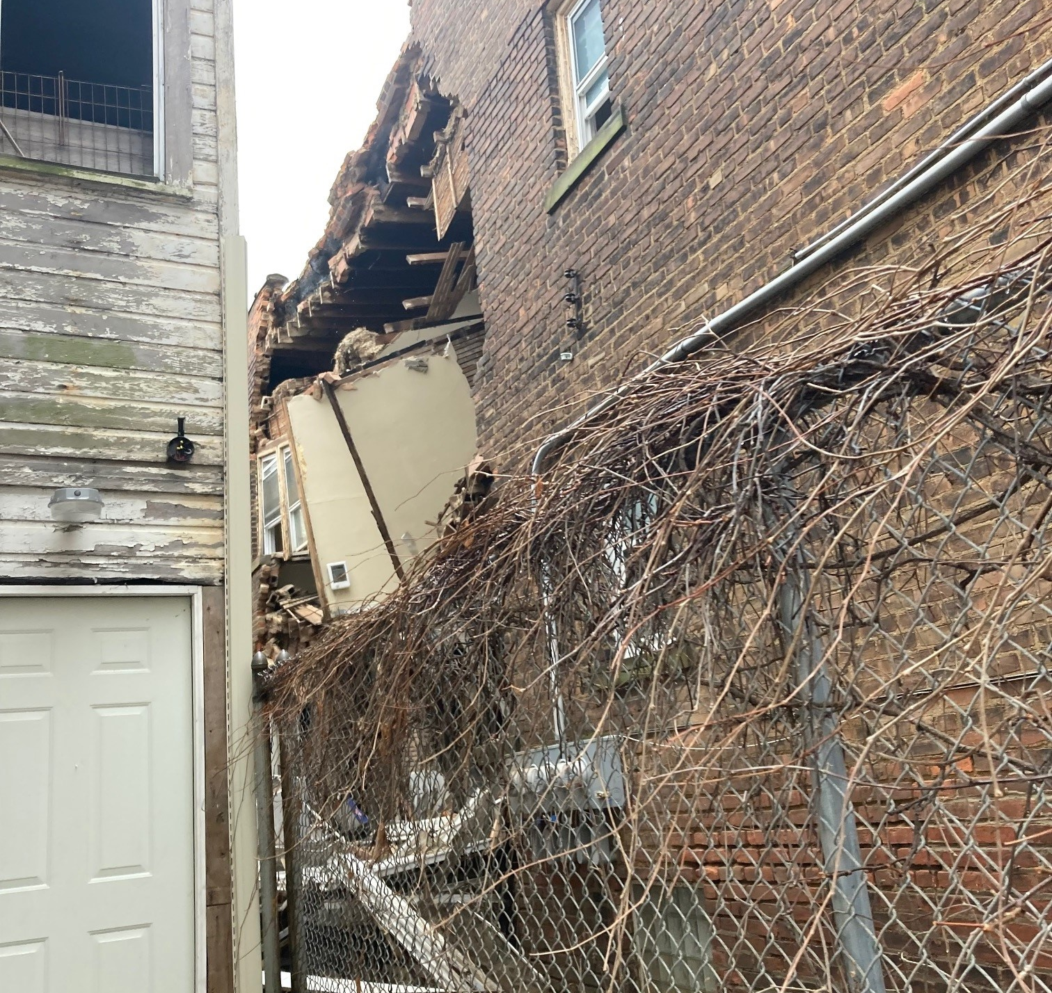
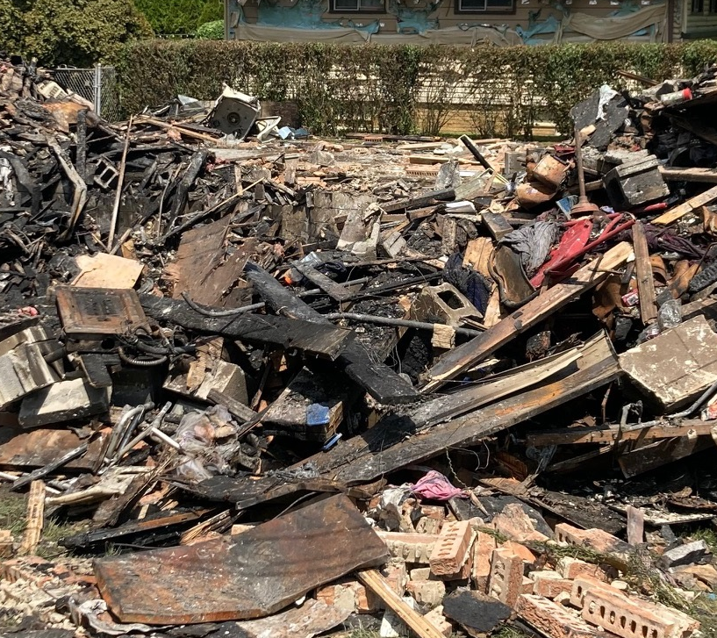
Home uninhabitable

Slide 35
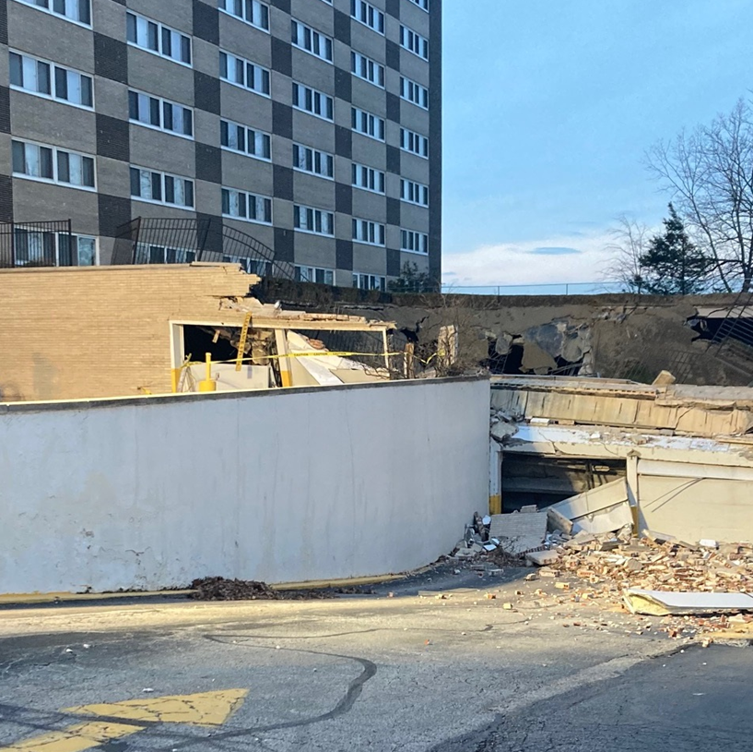
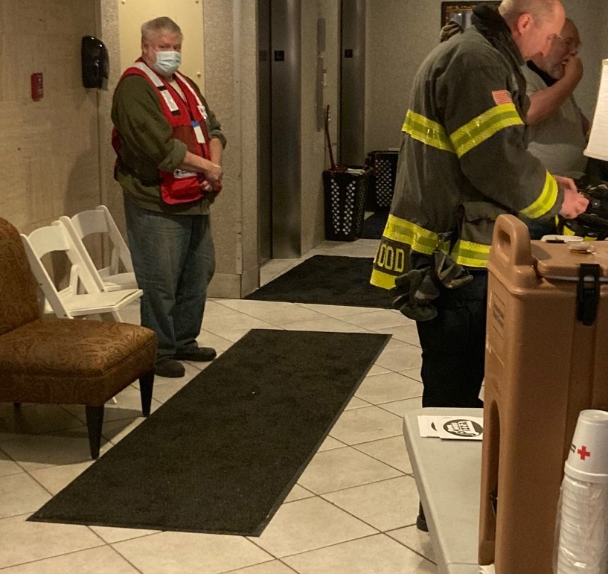
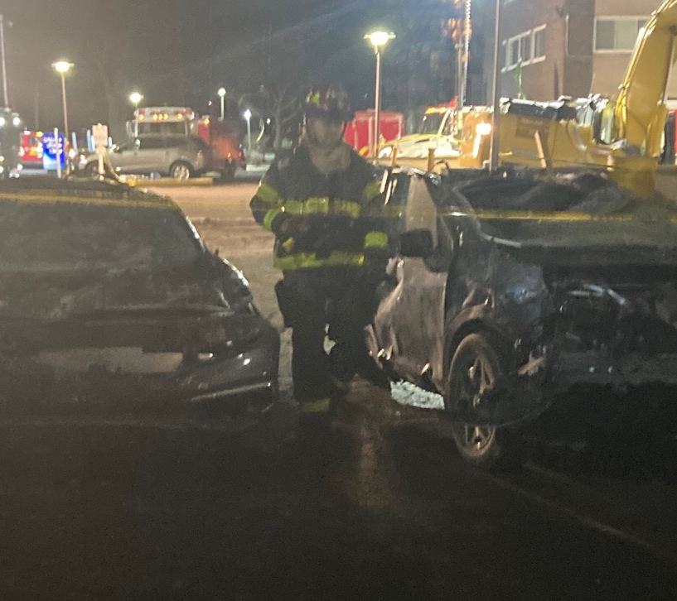
Lakewood Parking Garage Collapse

Slide 36
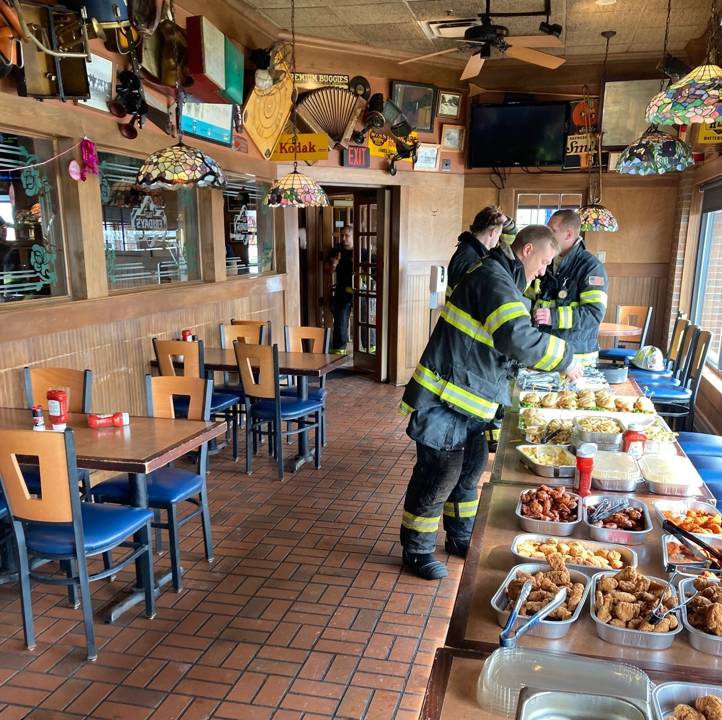
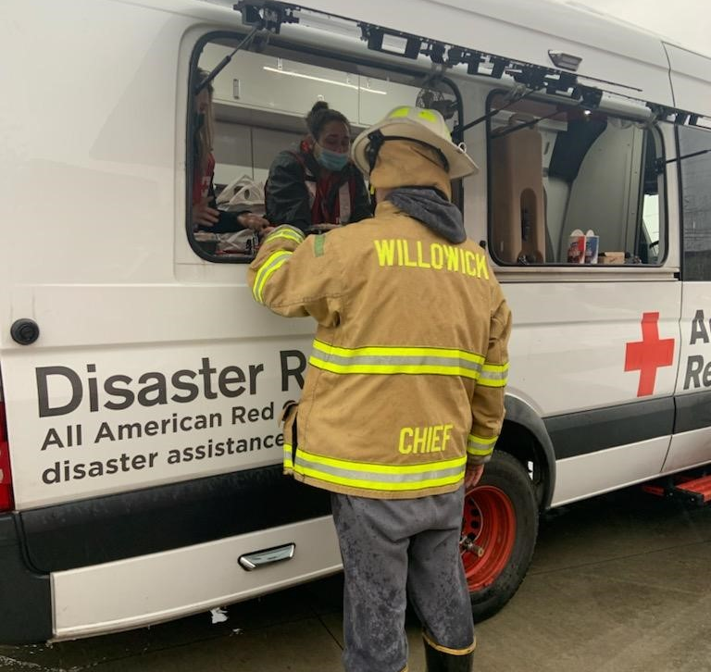
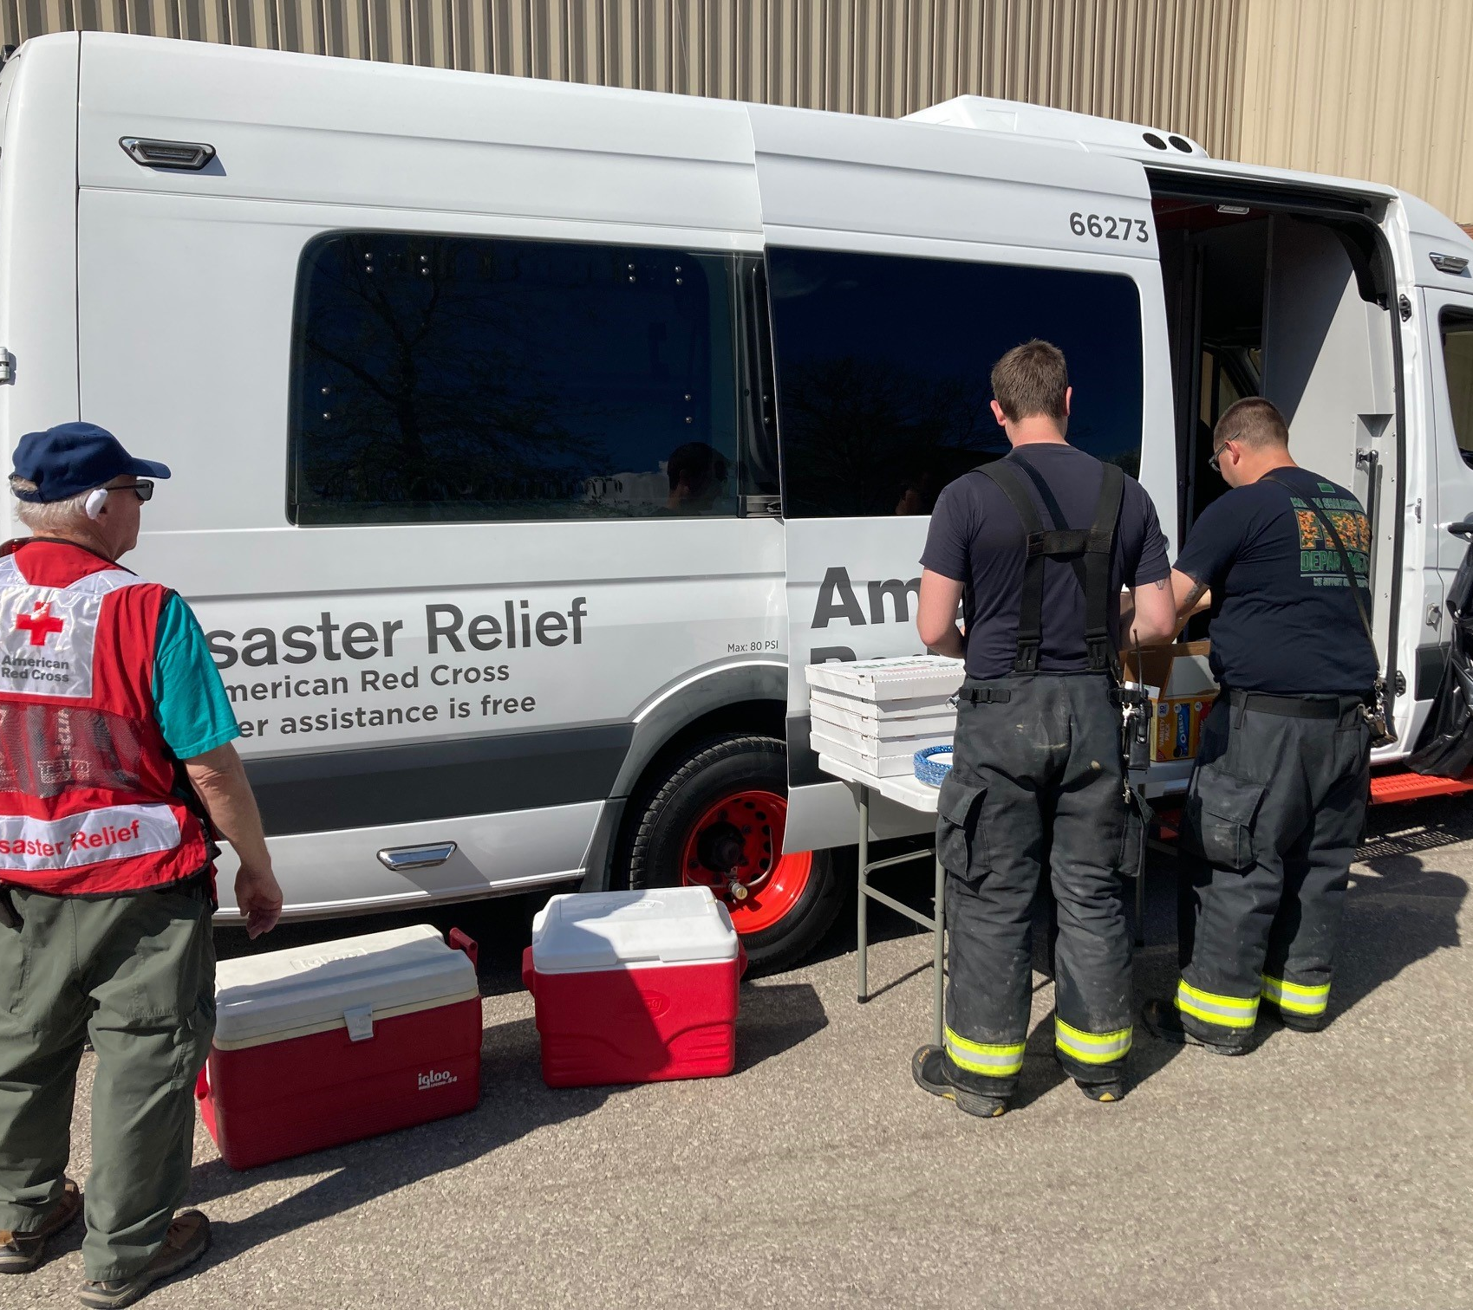
Canteens

Slide 37
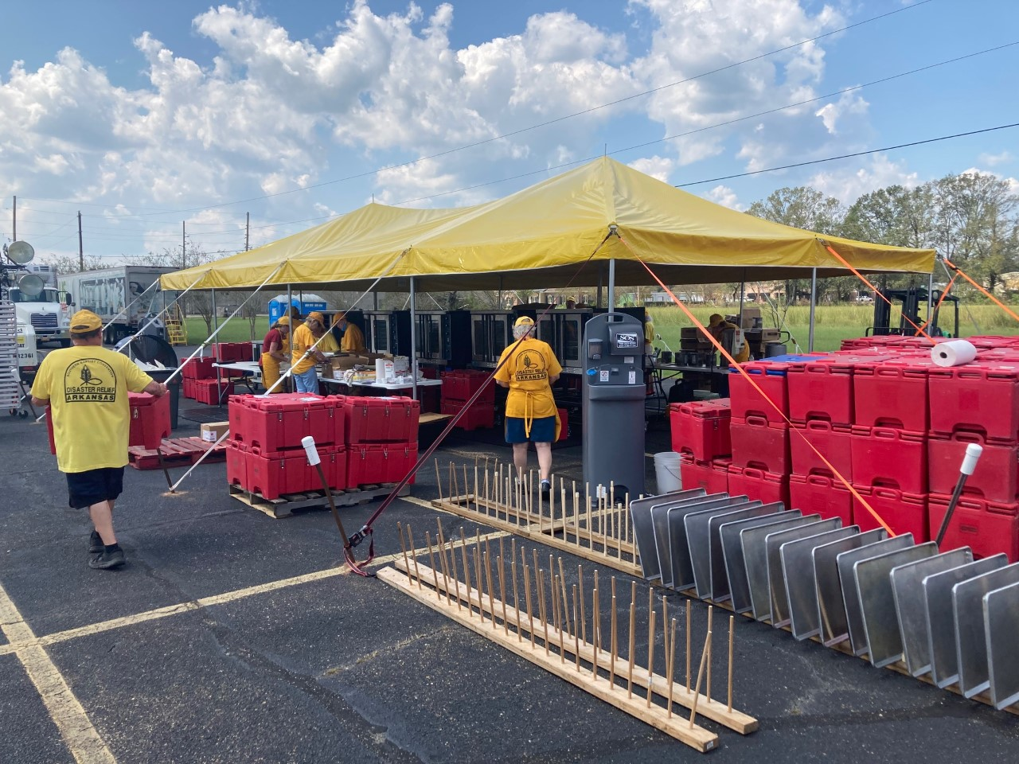
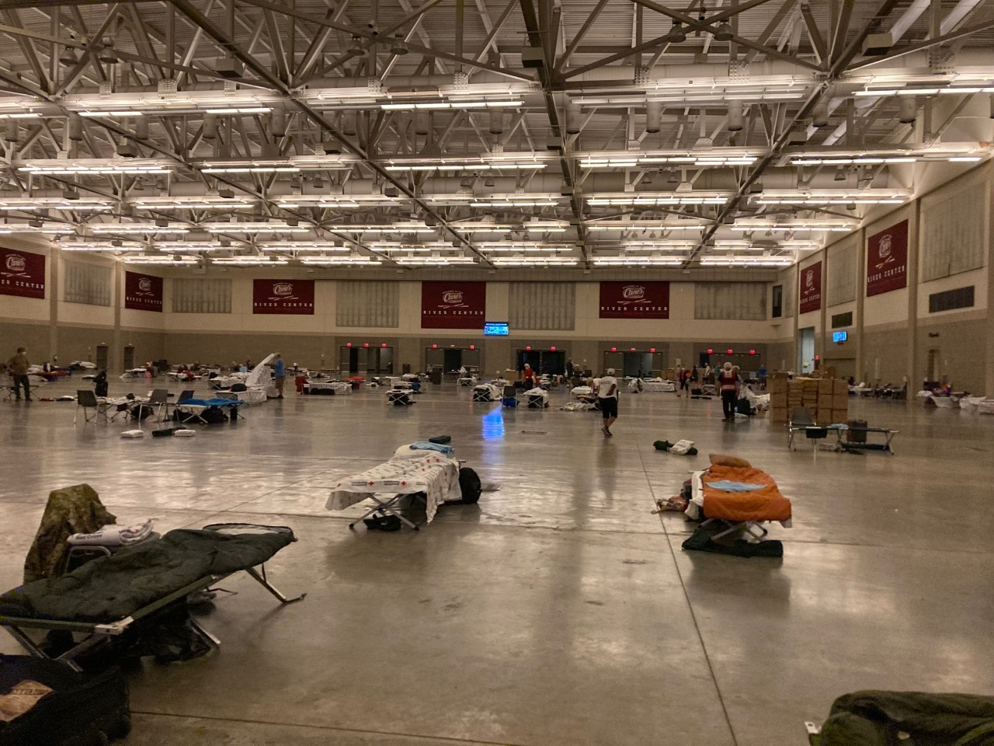
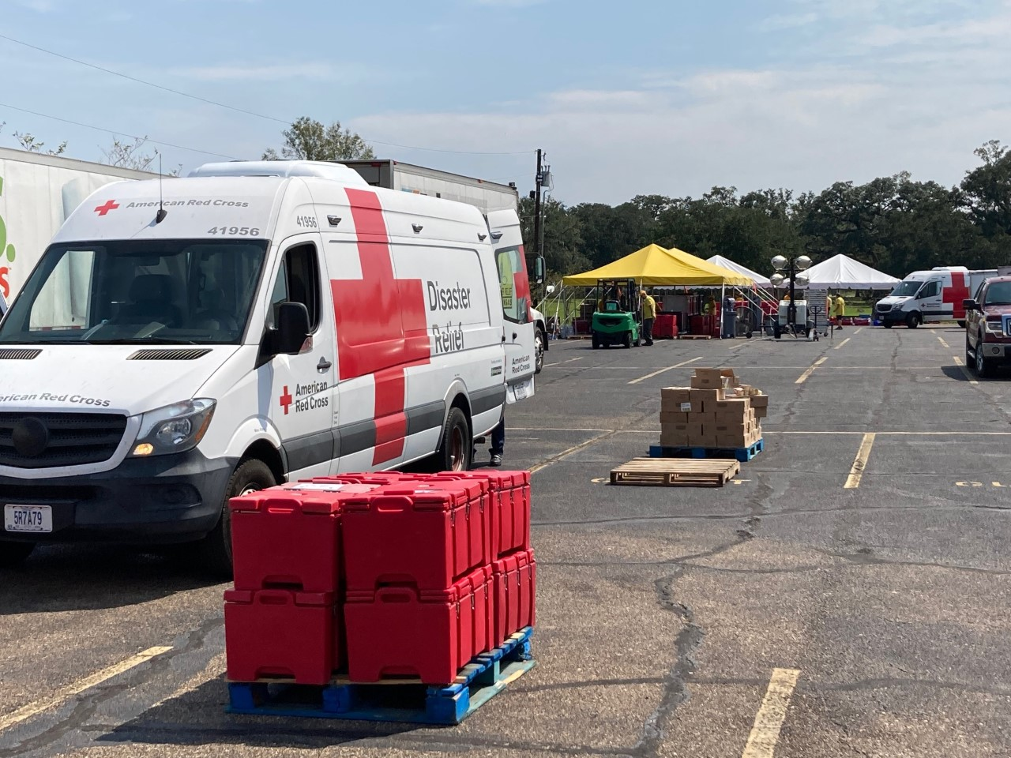
Large Disasters Response:
Sheltering
Feeding- fixed & mobile
EOC Staffing & Coordination
Health & Mental Health services
Spiritual Care
Damage Assessment
Bulk Distribution of supplies
Individual Casework
Long – Term Recovery
Northeast Ohio Chapter –100 Pre-Identified Shelters with 5 prepositioned Shelter trailers prepositioned and 1 ERV and 1 MRV
Notes:
Our region typically deploys nationally over 100 volunteers and staff every year to assist wildfires, floods, tornados and hurricanes

Slide 38
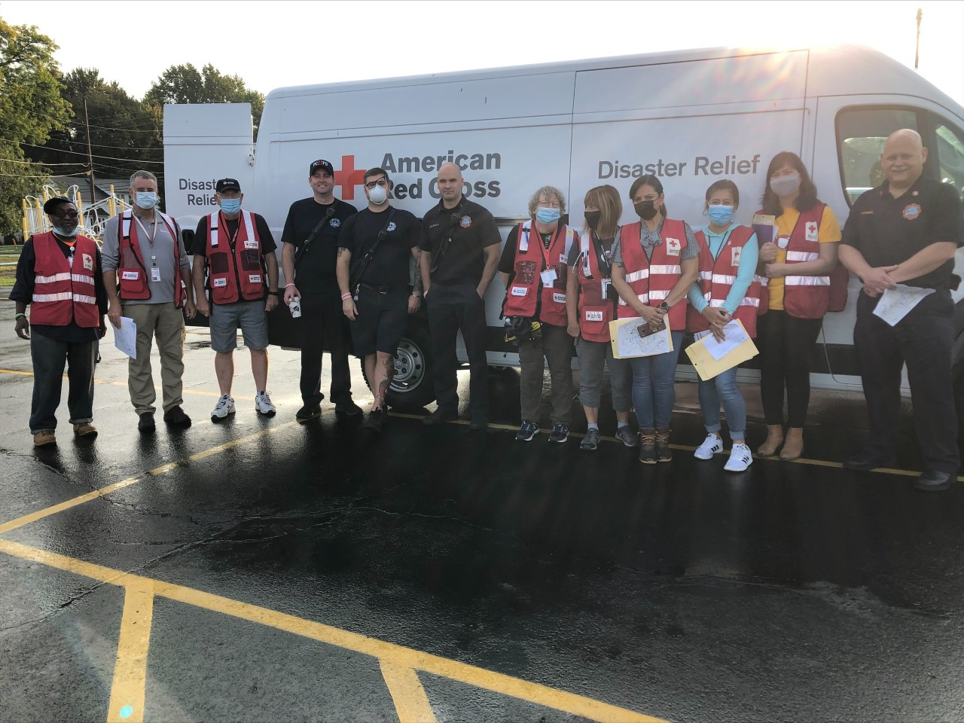
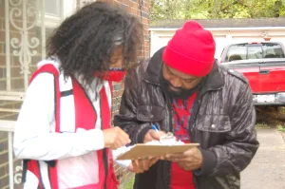
Preparedness:
Operation Save a Live : Smoke Alarm Installations
NEO Chapter – 3,737 installed
Northern Ohio Region – 8,520 installed
Project Pillowcase:
3rd thru 5th Grades; 40 to 60 minutes
Emergency Preparedness with physical activities and small group problem solving and discussions.
Learn mental health coping skills
Prepare with Pedro:
K thru 2nd grade: 30 to 45 minutes
Uses story telling and hands on activities students will build muscle memory and basic coping skills
Be red cross ready
Adult preparedness education
Red Cross Ready:
Teaches business a whole community approach to preparedness Education

Slide 39
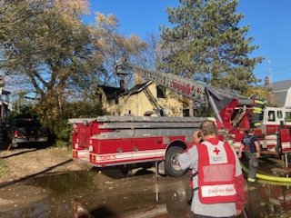
Volunteer opportunities:
Blood donor ambassador
ensure that blood donors have a pleasant and fulfilling experience, from the moment they arrive to the moment they leave. During a blood drive, they greet donors, answer questions or thanking them for their donation. The goal is that your courtesy and professionalism will create a favorable impression that encourages ongoing donor support
Disaster Action Teams (DAT)
The Disaster Action Team (DAT) serves as the first, on-the-scene, Red Cross contact at the site of a disaster. Typical duties:
Conducting damage assessment of affected dwellings and determining habitability
Initiating casework to ensure that people have shelter, food and clothing to meet immediate needs after a disaster
Supporting the “Mass Care” function, including assisting with feeding and shelter operations for larger scale disaster responses
Go to Redcross.org/volunteer

Slide 42
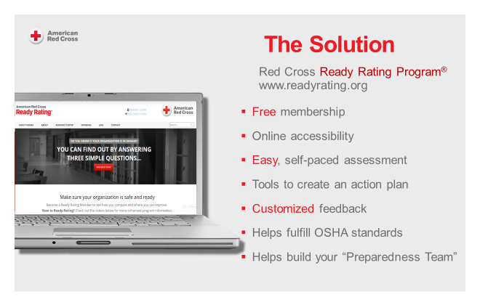

Slide 65
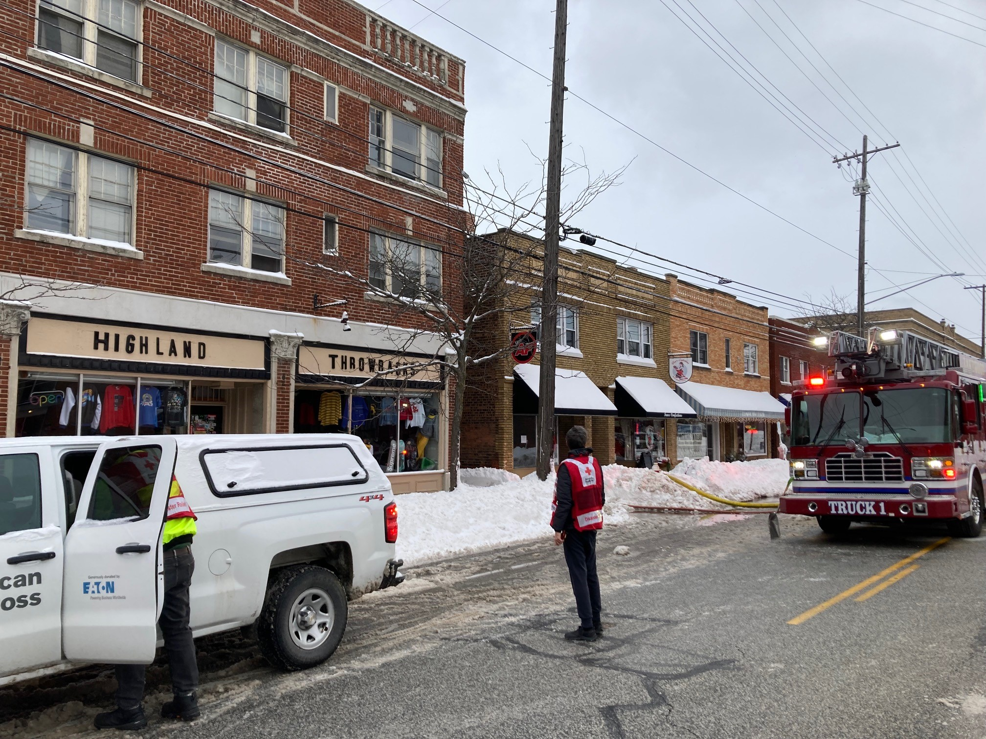
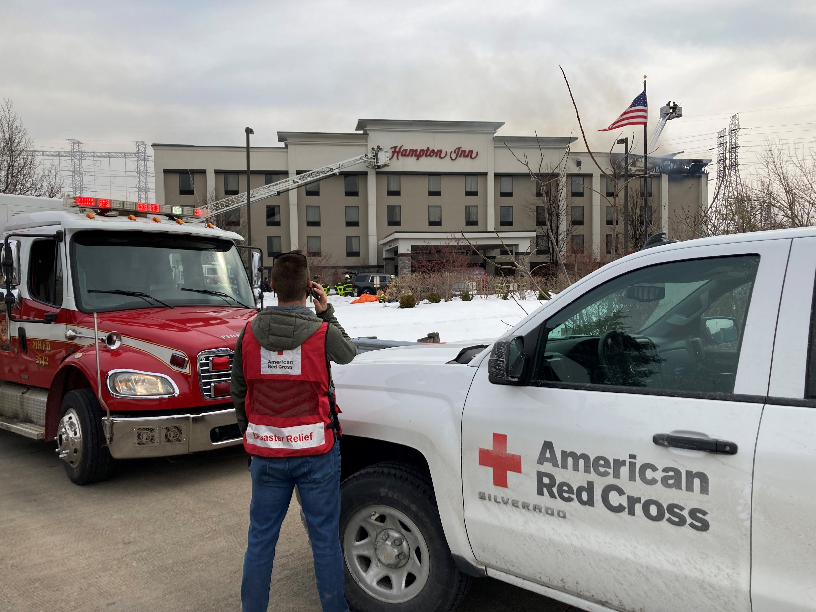
Questions or Comments

