Slide 1
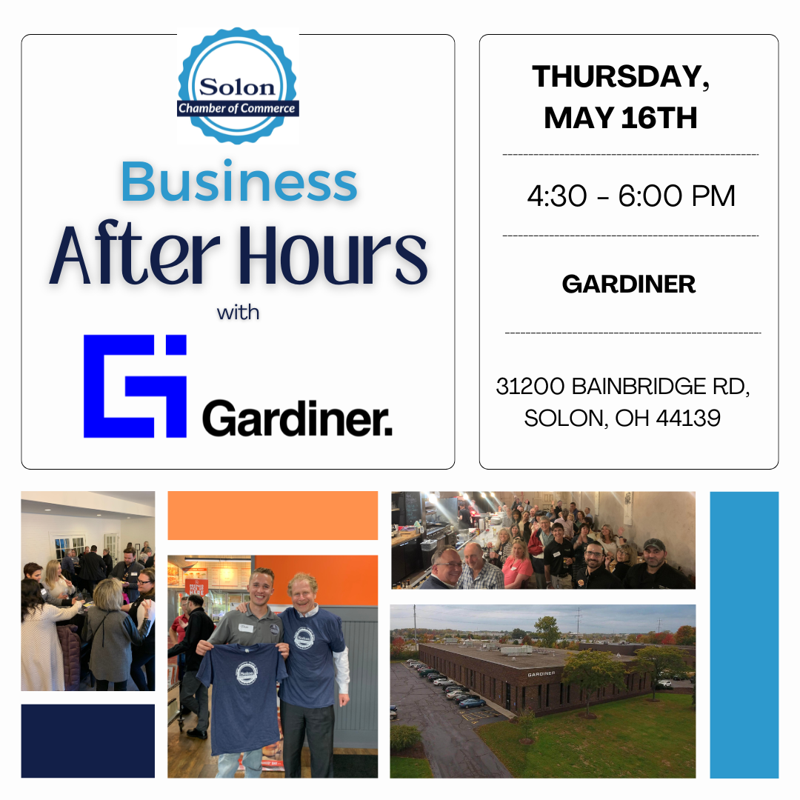

Slide 7
Program Sponsor

Slide 8
Program Sponsor

Slide 9
Slides, External resources & registration can be found at www.solonchamber.com/slides
Materials will also be distributed by email after the program!

Slide 10
June 12th
First Aid Basics with Aubi Nemeth, Sixth City CPR
July 10th
Hot Work/Heat Stress with Michael Gagermeier, August Mack Environmental

Slide 12
Monthly Learning May 2024
May 21-23, 28-29 - OSHA 30: Industry Safety Principles, 8:30 a.m. - 4:45 p.m. -Youngstown

Slide 13
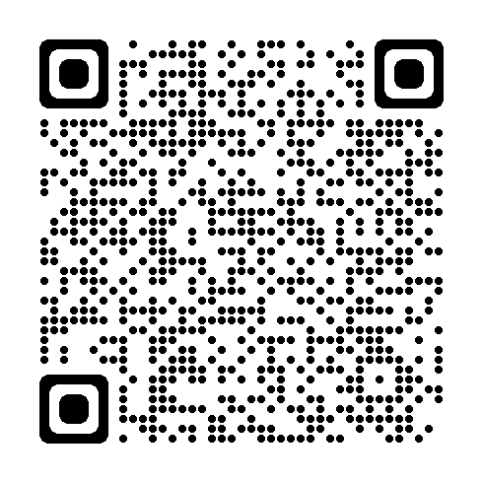
Monthly Learning June 2024
View the full schedule here
May 22- Safety for the non safety professional Canton
June 4 - Violence in the Workplace, 9 a.m. - 12:30 p.m. - Cleveland
June 12 - Controlling Workers’ Compensation Costs, 8:30 a.m. - 4:15 p.m. - Cleveland
June 26 - Lockout/Tagout and Safety Related Work Practices, 8:30 a.m. - 12:15 p.m. - Youngstown
IN-PERSON CLASSES and VIRTUAL TRAINING CLASSES (VTC) qualify for Safety Council rebate external training credits.
Notes:
Provided by Library/Email from Michelle F.

Slide 14
virtual training May 2024
May 9 - Wellness in the Workplace (VTC), 9:30 a.m. - 1 p.m.
May 14 - Developing a Driver Safety Program (VTC), 9:30 a.m. - 1 p.m.
May 21 - Machine Guarding (VTC), 9:30 a.m. - 1 p.m.
IN-PERSON CLASSES and VIRTUAL TRAINING CLASSES (VTC) qualify for Safety Council rebate external training credits.
Notes:
Provided by Library/Email from Michelle F.

Slide 15
virtual training June 2024
June 5 - Bloodborne Pathogens (VTC), 9:30 a.m. - 1 p.m.
June 13 - Safety Series Workshop Module 5: Electrical Safety and Lockout/Tagout Basics (VTC), 9:30 a.m. - 1 p.m.
June 18 - Accident Analysis Half-Day Workshop (VTC), 9:30 a.m. - 1 p.m.
June 20 - Safety Series Workshop Module 6: Machine Guarding and Powered Equipment Basics (VTC), 9:30 a.m. - 1 p.m.
IN-PERSON CLASSES and VIRTUAL TRAINING CLASSES (VTC) qualify for Safety Council rebate external training credits.
Notes:
Provided by Library/Email from Michelle F.

Slide 16
Upcoming webinars
May 8 - Lockout/Tagout: Controlling hazardous energy and your company program
May 23 - Secrets to food service employee safety
June 4 - If you have not measured it, did it happen? Tips for measuring safety performance
June 5 - Bloodborne Pathogens
June 11 - Powered industrial trucks: Addressing safety hazards for operator and pedestrians
July 30 - High hazard focus four inspections: Be prepared when PERRP shows up at your doorstep

Slide 17
Employer Deadline Dates
Private Employer Deadlines
May 31 - Drug-Free Safety Program (DFSP) application deadline for 7/1/2024 start date May 31 - Transitional Work Bonus application deadline for 7/1/2024 start date
June 21 - Policy year 2024 first installment due June 28 - Deadline for Grow Ohio safety requirements if coverage became effective between July 1 and Dec. 31
Public Employer Deadlines
May 31 - Group Experience Rating Program application deadline for 1/1/2025 start date

Slide 19
Contact: Laura M. Cox, Senior Manager-Business Development laura.cox@sikich.com 330.221.1703 or
Matthew Doherty, Managing Director matthew.doherty@sikich.com 202.306.6530

Slide 20
Workforce risk management
Whether it’s an improving or establishing a workplace violence prevention program, training your team members or managing an urgent threat concern, we offer expert advisory services to strengthen your efforts in violence prevention, threat assessment and management, organizational response and crisis communications.
PROGRAM SUPPORT
TRAINING
THREAT MANAGEMENT
Workplace Violence Prevention Program Needs Assessment
Workforce Perception Surveys
WVP Policy and Program Development
Recordkeeping Tools
Security Vulnerability Assessments
WVP Fundamentals for the Workforce, Compliant with CA SB553 Legislation
Active Assailant Response
WVP Training for People Leaders
Conflict Resolution and De-escalation Training
Threat Management Team Workshop
On-Demand Threat Case Consultation
Behavioral Threat Assessment
Investigations
Psychological Evaluations of Violence Risk Potential
Open Source Intelligence
Threat Case Management Support
Now providing turnkey support to ensure compliance with California SB553
Contact: Laura M. Cox, Senior Manager-Business Development laura.cox@sikich.com 330.221.1703 or
Matthew Doherty, Managing Director matthew.doherty@sikich.com 202.306.6530

Slide 21
CURRENT & ALIGNED
Aligned with standards, guidance and the latest research at the forefront of proactive violence prevention and behavioral threat management including:
Occupational Safety and Health Agency (OSHA)
Society of Human Resource Management (SHRM)
Association of Threat Assessment Professionals (ATAP)
ASIS International
Department of Defense (DOD)
Department of Homeland Security (DHS)
Federal Bureau of Investigation (FBI)
National Insider Threat Task Force (NITTF)
United States Secret Service (USSS)
Contact: Laura M. Cox, Senior Manager-Business Development laura.cox@sikich.com 330.221.1703 or
Matthew Doherty, Managing Director matthew.doherty@sikich.com 202.306.6530

Slide 22
the benefits of proactive prevention
Reacting to a serious incident of workplace violence is 100 times more expensive than taking proactive measures for prevention
- National Institute for Prevention of Workplace Violence
FINANCIAL IMPACT ON COMPANY/ORGANIZATION
Research shows that there are significant financial impacts on companies and organizations when violence enters the workplace. Each occurrence of workplace violence can result in:
$130 billion financial impact of WVP annually
50%
20-40%
$500,000
$3M
In productivity for the organization
In employee turnover
Average out-of-court settlement
Average jury award for a lawsuit
Contact: Laura M. Cox, Senior Manager-Business Development laura.cox@sikich.com 330.221.1703 or
Matthew Doherty, Managing Director matthew.doherty@sikich.com 202.306.6530
22

Slide 23
Contact: Laura M. Cox, Senior Manager-Business Development laura.cox@sikich.com 330.221.1703 or
Matthew Doherty, Managing Director matthew.doherty@sikich.com 202.306.6530

Slide 24
Program Sponsor
www.ussafetygear.com

Slide 25
CONTACT INFORMATION
25
PRADCO
178 E. Washington St.
Chagrin Falls, OH 44022
Main Office: (440) 337-4700
Office Hours: 7:30am – 5:00pm weekdays
www.pradco.com

Slide 26
PRADCO respectfully wishes not to share their presentation, please reach out to the following contacts for more info:
Joe Lubin, Director of Business Development | jlubin@pradco.com or (440) 337-4714
Patrick Johnson, Sr. Management Consultant | pjohnson@pradco.com or (440) 337-4634

